Slide 1

COVID MANAGEMENT SYSTEM
BY MOHID CHOUGLE.

Slide 2

Agenda
Introduction
ER DAIGRAM
QUESTIONS
CONCLUSION

Slide 3

Introduction
A Covid management system is use to manage the data of covid patients, hospital and after test result.
The intention for creating this system is to show the critical condition of pandemic and people infected by it.

Slide 4
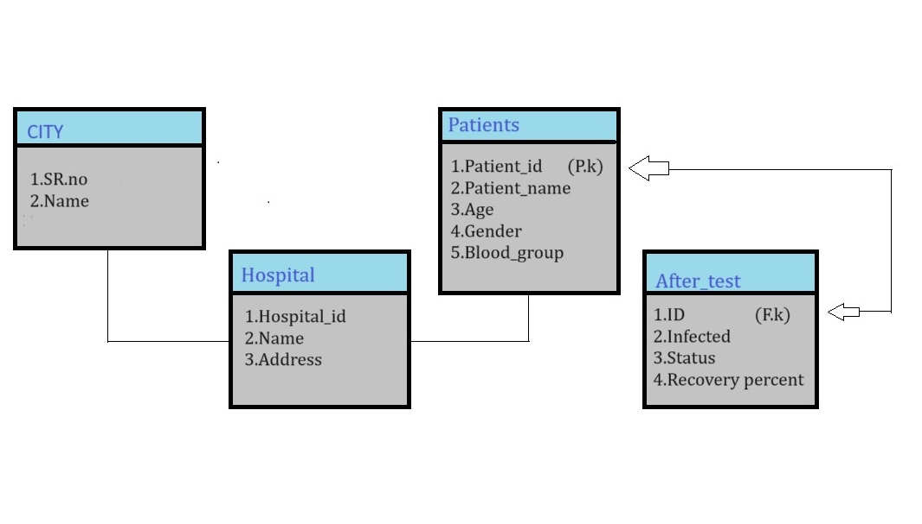
ER DIAGRAM

Slide 5
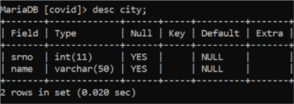
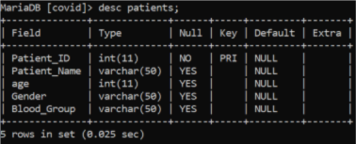
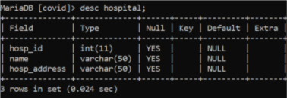
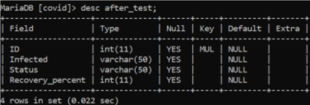
HOW TO DESCRIBE TABLES?
___________________
Desc TABLE NAME;

Slide 6
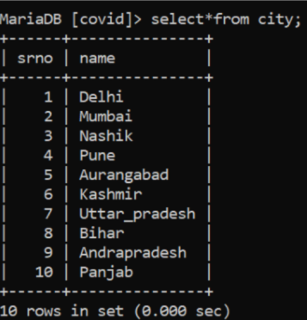
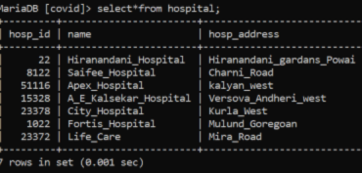
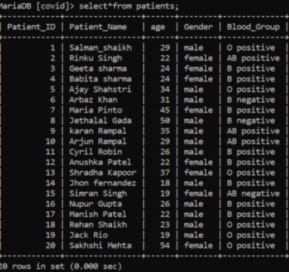
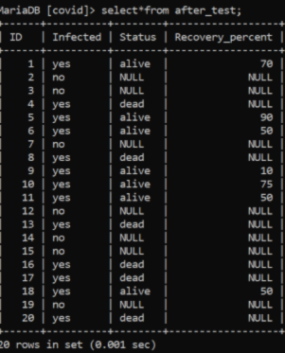
HOW TO SEE VALUES INSIDE TABLES?
Select*from TABLE NAME;

Slide 7
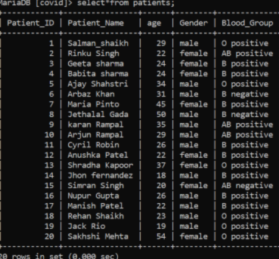
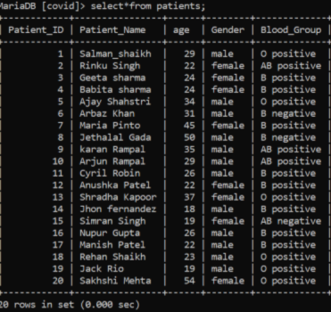
How to use update function?
Update patients set age=20 where patient_id=15;

Slide 8
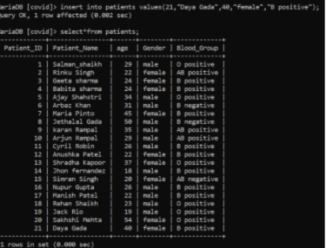
HOW TO INSERT VALUES IN TABLE?
Insert into patients values(21,"Daya Gada,40,"female","B positive");

Slide 9
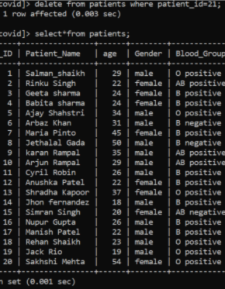
HOW TO USE DELETE FUNCTION?
Delete from patients where patients_id=21;

Slide 10
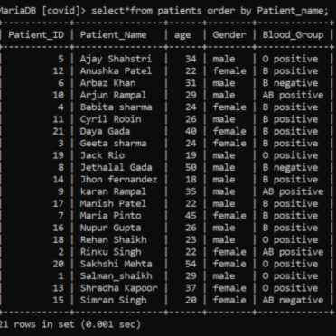
HOW TO ARRANGE IN ALPHABETIC ORDER?
BY USING ORDER BY CLAUSE.

Slide 11
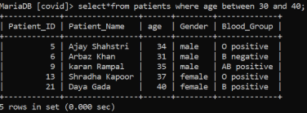
HOW TO CHECK PATIENTS AGE BETWEEN 30 TO 40?
BY USING BETWEEN OPERATOR.

Slide 12
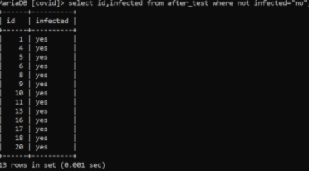
How to check patIents who are infected by covid?

Slide 13
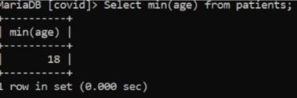
HOW TO CHECK MINIMUM AGE OF THE PATIENTS?
BY USING MIN FUNC

Slide 14
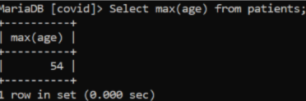
HOW TO CHECK MAXIMUM AGE OF PATENTS?
BY USING MAX FUNCTION.

Slide 15

How to view total number of male and female?
-------------------------By using group by clause.

Slide 16
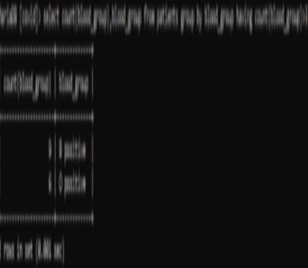
How to see which clones blood group had been used more than 3 times?
select count(blood_group),blood_group from patients group by blood_group having count(blood_group)>3;

Slide 17
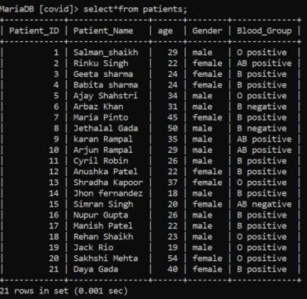
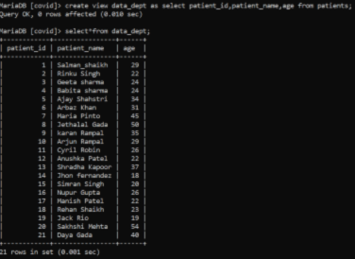
HOW TO USE VIEW IN SQL?
PARENT TABLE
DATA_DEPT TABLE

Slide 18
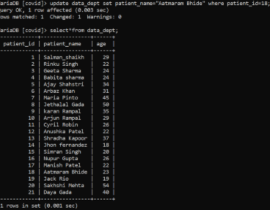
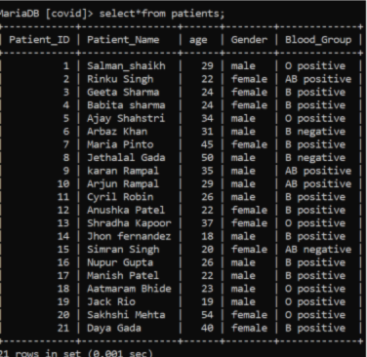
AFTER CHANGING VALUE
PARENT TABLE

Slide 19
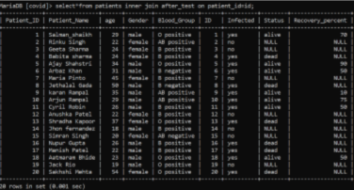
HOW TO MERGE BOTH THE TABLE?

Slide 20

CONCLUSION --------------- SQL is relatively easy to use. It is a powerful query language. During the project I have learn so many technical skills. And gain practical understanding and knowledge.

Slide 21

THANK YOU!

